Slide 1
Rating Hospital Performance
Brining Consumerism to Healthcare
June 5th, 2019
Presenters: Marin Gow, Michael Diarra, Venku Buragadda, Zain Iqbal & Zain Jafri

Slide 2





Agenda & Presentation Outline
Background & Problem Statement
Data Overview & Exploration
Data Preparation & Feature Extraction
Modeling Approach & Evaluation
Challenges, Recommendations & Future Opportunities

Slide 3





Consumerism Is Everywhere
In nearly every industry and sector, consumer power has grown in the last 10 years as the availability of data has given consumers previously unknown levels of transparency into the quality of goods and services provided.

Slide 4

Except for the Healthcare Industry
The need and opportunity is there…
…significant investment has been made…
…major challenges still exist in driving improved quality
Each year 1.7M Americans develop hospital acquired infections
Approximately 99,000 of those patients die
Many of these cases are considered preventable
Variation in health outcomes continues to be a major challenge
Data collection and reporting is not timely – often lagging 1-3 years (depending on the data set)
Reporting is not easy for consumers to access and interpret
Stakeholder incentives are often not aligned
Relevant Programs
Hospital Consumer Assessment of Healthcare Providers & Systems (HCAHPS) – Patient Quality Surveys
Hospital Complications & Deaths Data Set – Prevalence of Complications & Deaths
These measure are used to calculate a Hospital Star Rating (1-5) to indicate overall quality and performance

Slide 5
Problem Statement
Our goal is to develop a predictive regression model, which can effectively predict the Star Rating of a hospital, using the HCAHPS Patient Survey and Complications & Deaths data sets.
Ultimately, we believe this can be used to create a more real-time application patients can use to determine which hospitals they utilize for non-emergency care.¹
Notes: 1) Further discussed in the Recommendations section of our presentation.

Slide 6
Data Overview & Exploration
Will we need a second slide for the imputation? Could be a good way for us to call out our methodology.

Slide 7
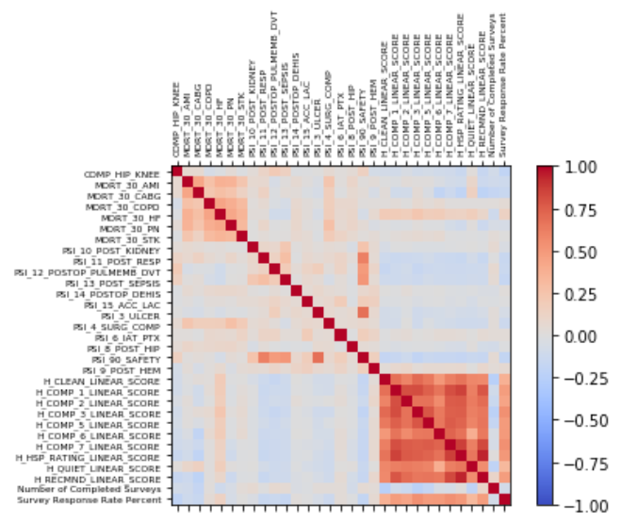
Data Preparation
Complications and Survey datasets combined using shared Provider ID
Dropped high cardinality features such as zip code and state
Selected Star Rating and Recommended Linear Score as our target variables

Slide 8
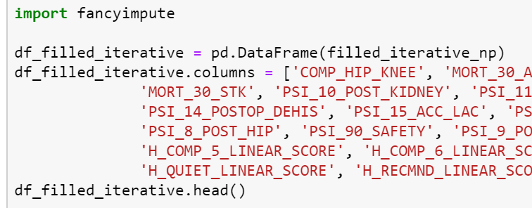
Imputation
Three imputation methods:
Mean
Linear regression
KNN
Linear regression performed best across most of our models

Slide 9
Modeling Approaches Utilized: Regression
We tested several modeling approaches, however ultimately landed on [Model X] due to….
 | Model 1 | Model 2 | Model 3 | Model 4
Overview
Performance | Accuracy Precision Recall F1 Score RMSE

Slide 10
Modeling Approaches Utilized: Classification
We tested several modeling approaches, however ultimately landed on [Model X] due to….
 | Model 1 | Model 2 | Model 3 | Model 4
Overview
Features
Parameters
Performance | Accuracy Precision Recall F1 Score RMSE

Slide 11
Selected Model
We tested several modeling approaches, however ultimately landed on [Model X] due to….

Slide 12
Feature Refinement & Final Model
I am assuming similar to the homework we may run initial models and then refine the features; in which case we may want this slide. However, if not, we can delete.

Slide 13
Model Outcomes
A timely hospital quality and performance reporting application for consumers
Based on consumer surveys and voluntary reporting from hospitals
Reports an overall score and ranking for each hospitals in a region
Used by consumers to determine where they may seek non-emergency care
For this slide, I think we should take the outputs of the model and pick a region/geography to do a deep dive on the results and what the application would be. E.g., rank hospitals in Chicago to show how they perform relative to one another.
I could also foresee this being multiple slides of graphical outputs, similar to the example we looked at. We probably need to further discuss/think more about what these would be.

Slide 14
Recommendations
Based on Hospital Complication Scores and Patient Ratings the model predicts a reliable CMS Rating Score which evaluates hospital performance
No longer need to wait two years to receive an accurate CMS Rating for hospitals
Rating scores include actual hospital performance and patient survey feedback rather than just patient surveys
Care Transition and Nurse Communication appear to be the biggest drivers of higher scores and predictability
Hospital Complication Scores
Patient Ratings
Predict Score Rating
Best Hospital Ranking for User

Slide 15
Challenges and Model Improvements
Challenges
Missing Values: Only roughly 25% of the data had all the variables filled out and the other 75% was used by regression imputation
Data Lag: Data has a two year lag period and we need a reporting mechanism to feed in more recent information
Hospital Features: Features regarding the hospitals themselves are missing to develop a reliable NetworkX ranking analysis
Overfitting: Need feedback from team
Model Improvements
PageRank: Model can be improved by adding hospital features to develop accurate edges and nodes for a hospital rank recommendation
Complication Scores Limitation: CMS complications scores only include 20 different complication types – with additional complications the model can predict better rating scores and provide more accurate recommendations based on patient’s current complication

Slide 16
References
Reference 1
Reference 2

